Slide 1
Contrast loss and radiation damage of cryoEM images
Szu-Chi Chung
Institute of Statistical Science, Academia Sinica

Slide 2
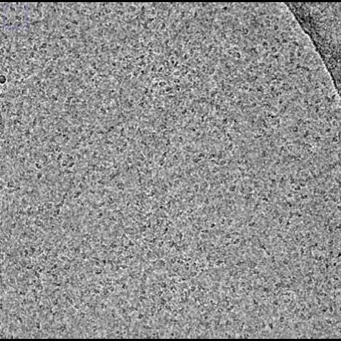
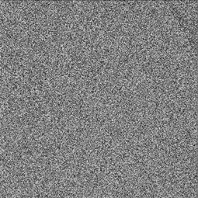
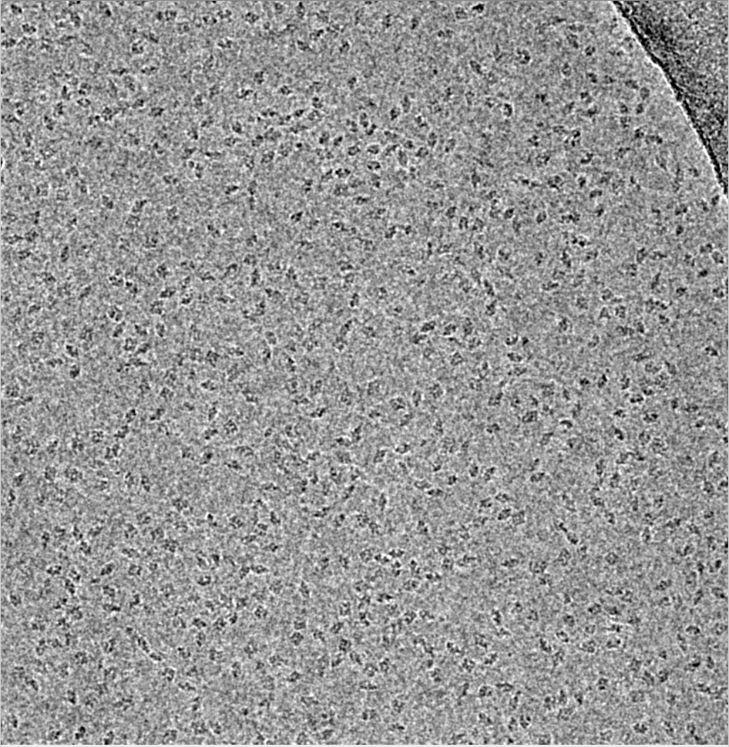
Introduction
Per-frame analysis
Motion estimation
CTF estimation
Relative contrast

Slide 3
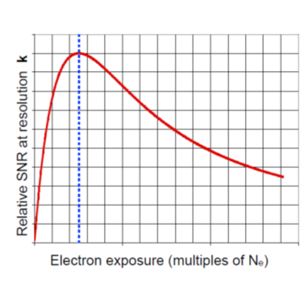
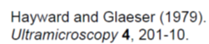
Movie Stacks [2]
The ability to collect movies allows us to quantify specimen movement and analyze the radiation damage
Frame 1 2 3 4 5 6 7 8 9 10
Notes:
Specific resolution k
Eletron microscope
High reso are destroy first
單張 多張

Slide 4
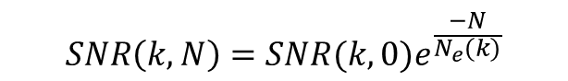
Dose Weighting – Empirical on crystal data [2]
Fall-off of intensity versus exposure
Direct measure diffraction spot
Single exponential decay
Holds for image series
$$SNR\left(k, N\right)=SNR(k,0)e^{\frac{−N}{N_{e}(k)}}$$
Notes:
Higher resolution, exposure less
High resolution give early frame more weight!
Hydrated ice 2d image
Crystal specimen in ice direct measure
過氧化氫酶

Slide 5
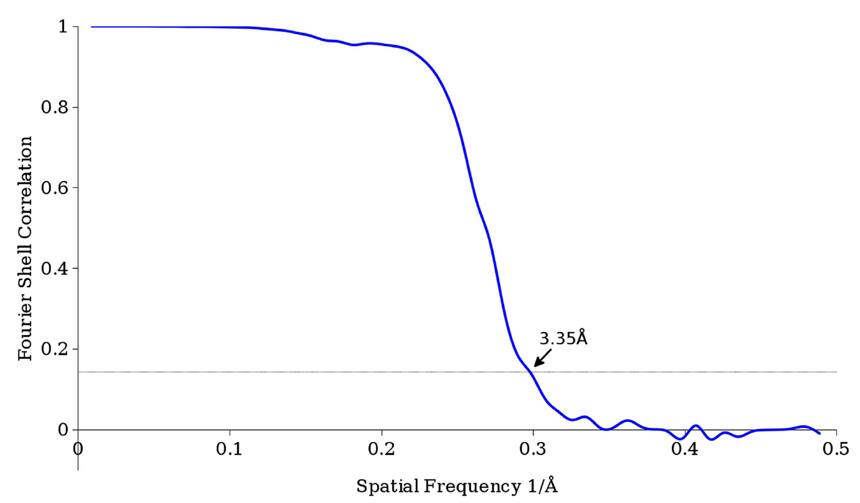
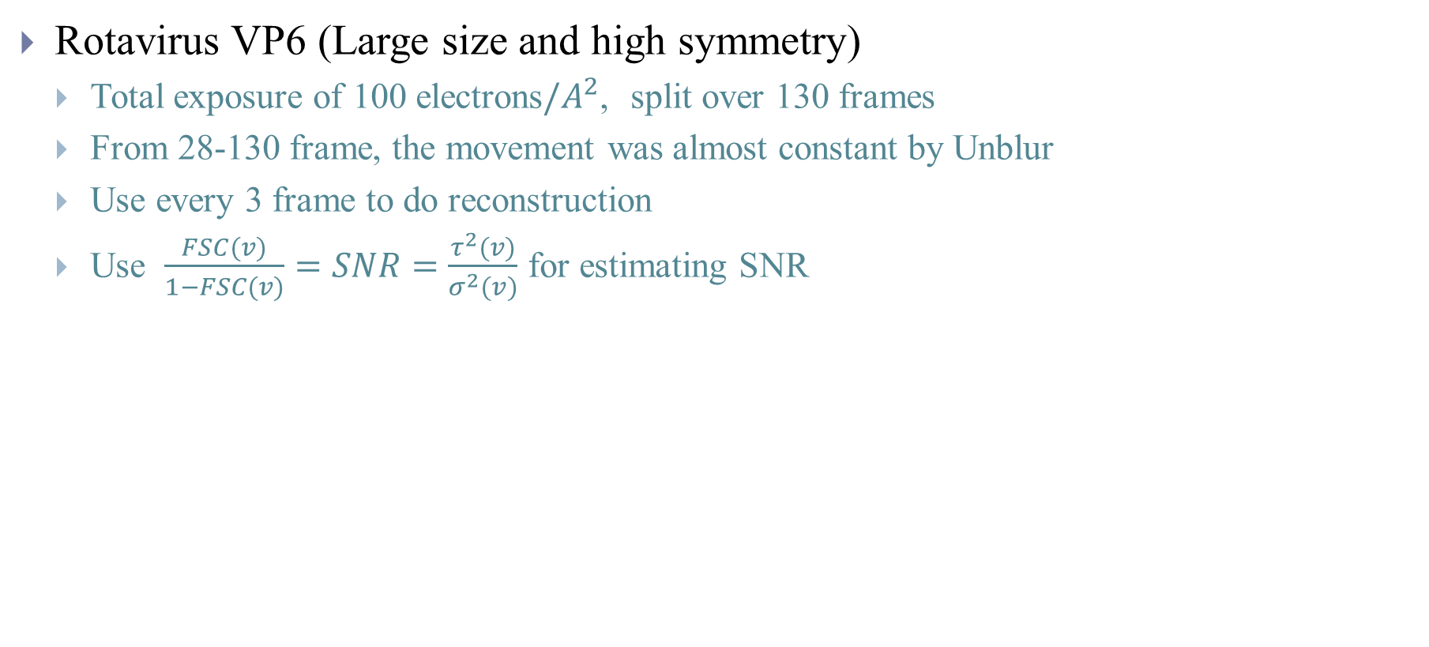
Dose Weighting – Empirical on single particle data[3]
Rotavirus VP6 (Large size and high symmetry)
Total exposure of 100 electrons$/A^{2}$, split over 130 frames
From 28-130 frame, the movement was almost constant by Unblur
Use every 3 frame to do reconstruction
Use $\frac{FSC(v)}{1−FSC(v)}=SNR=\frac{τ^{2}(v)}{σ^{2}(v)}$ for estimating SNR
frame 28
frame 130
Use above plot to give weights $w_{f}\left(k\right)$ to each frame
Notes:
VP6
Few particles can obtain 3A

Slide 6
Deal with radiation damage
Unblur, MotionCor2 use dose weighting at the beginning
Particle polishing use the final 3D structure information to obtain weight and do a second pass of processing flow

Slide 7
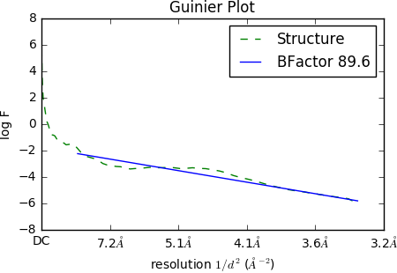
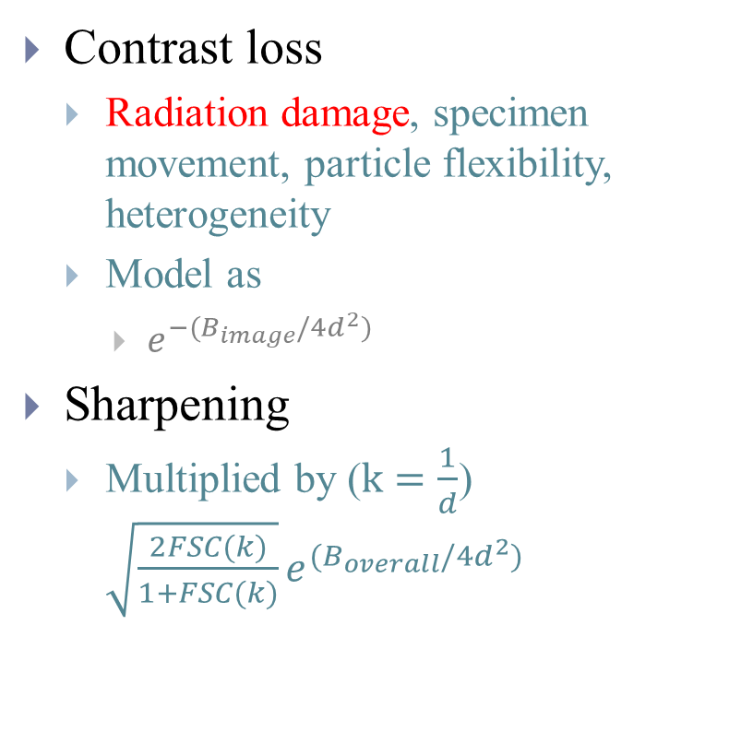
Guinier Plot [1]
Contrast loss
Radiation damage, specimen movement, particle flexibility, heterogeneity
Model as
$e^{−(B_{image}/4d^{2})}$
Sharpening
Multiplied by ($k=\frac{1}{d}$) $\sqrt{\frac{2FSC(k)}{1+FSC(k)}}e^{(B_{overall}/4d^{2})}$
Notes:
0.28 Solvent contrast
PSSNR

Slide 8
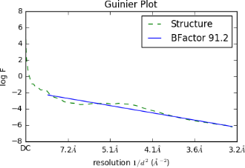
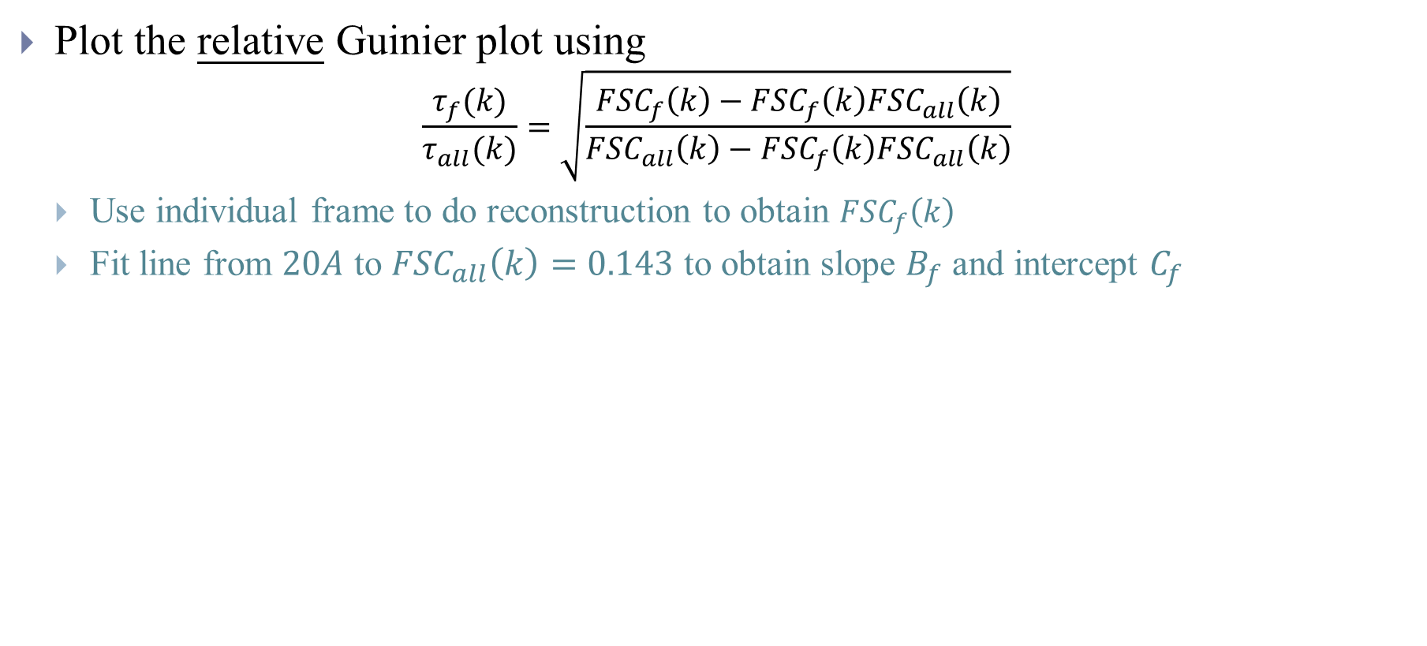
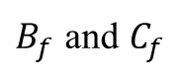
Particle polishing – B factor weighting from data [4]
Plot the relative Guinier plot using
$$\frac{τ_{f}(k)}{τ_{all}(k)}=\sqrt{\frac{{FSC}_{f}\left(k\right)−{FSC}_{f}\left(k\right){FSC}_{all}\left(k\right)}{{FSC}_{all}\left(k\right)−{FSC}_{f}\left(k\right){FSC}_{all}\left(k\right)}}$$
Use individual frame to do reconstruction to obtain ${FSC}_{f}\left(k\right)$
Fit line from $20A$ to ${FSC}_{all}\left(k\right)=0.143$ to obtain slope $B_{f}$ and intercept $C_{f}$
$B_{f}$ and $C_{f}$
Notes:
從b factor來看訊號damage another view
10-20 enough signal
40 frame -> 80 reconstructions
B factor quantify residue motion

Slide 9
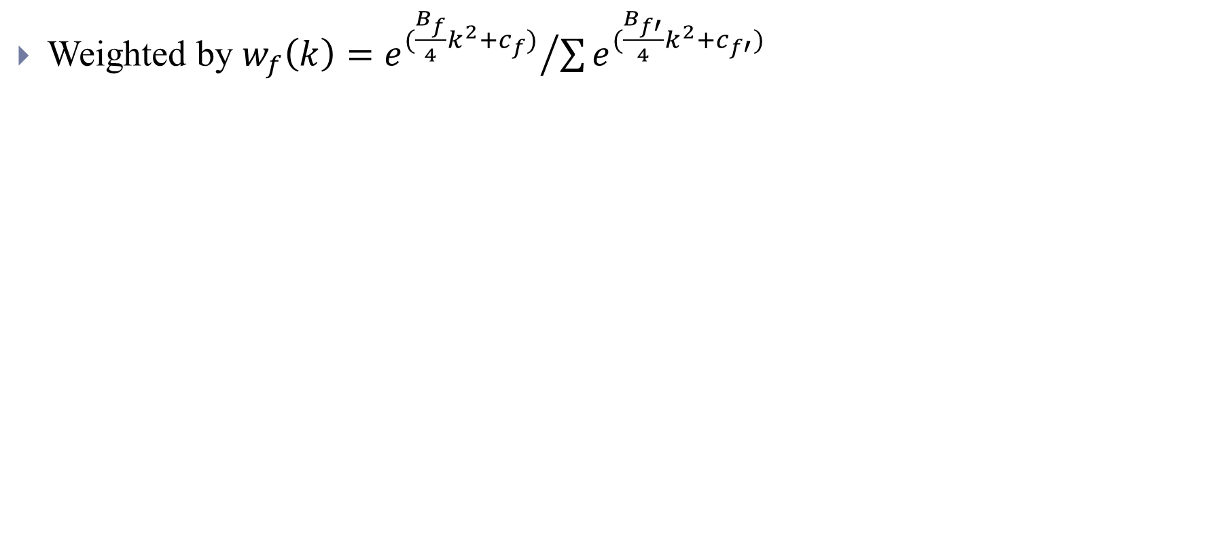
Particle polishing – B factor weighting from data [4]
Weighted by $w_{f}\left(k\right)={e^{(\frac{B_{f}}{4}k^{2}+c_{f})}}/{\sum{e^{(\frac{B_{f′}}{4}k^{2}+c_{f′})}}}$
Notes:
Cf frequency independent component
Bf fall-off of high frequency component

Slide 10
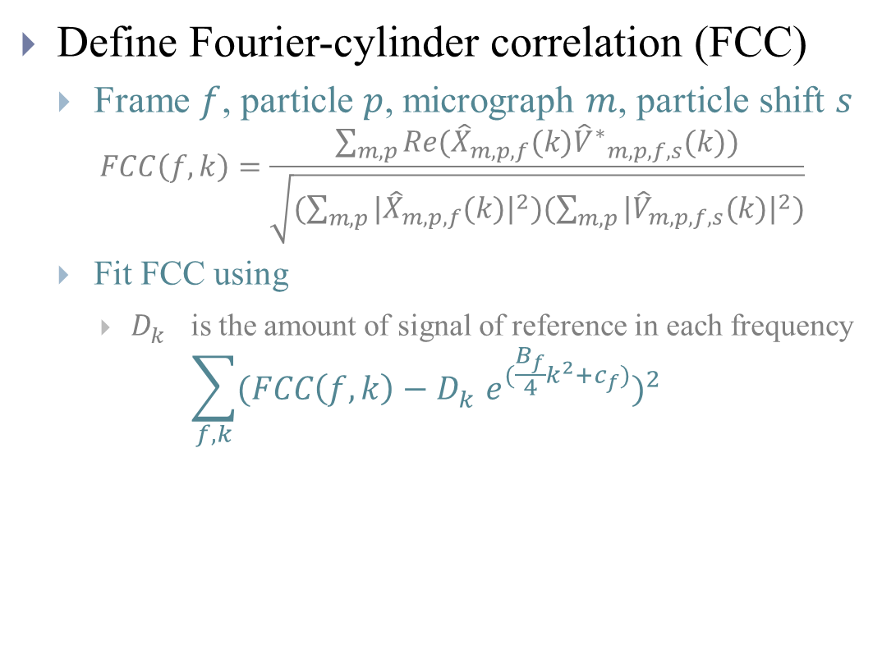
Bayesian Polishing – B factor weighting from data [5]
Define Fourier-cylinder correlation (FCC)
Frame $f$, particle $p$, micrograph $m$, particle shift $s$
$$FCC\left(f,k\right)=\frac{\sum_{m,p}{Re({\hat{X}}_{m,p,f}(k){{\hat{V}}^{∗}}_{m,p,f,s}(k))}}{\sqrt{(\sum_{m,p}{{|{\hat{X}}_{m,p,f}(k)|}^{2}})(\sum_{m,p}{{|{\hat{V}}_{m,p,f,s}(k)|}^{2}})}}$$
Fit FCC using
$D_{k}^{}$ is the amount of signal of reference in each frequency
$$\sum_{f,k}{{(FCC\left(f,k\right)−D_{k}^{}e^{(\frac{B_{f}}{4}k^{2}+c_{f})})}^{2}}$$
Notes:
Model both radiation damage and residual motion that is not corrected for
Dk equals to eb average fscavrage initial?

Slide 11
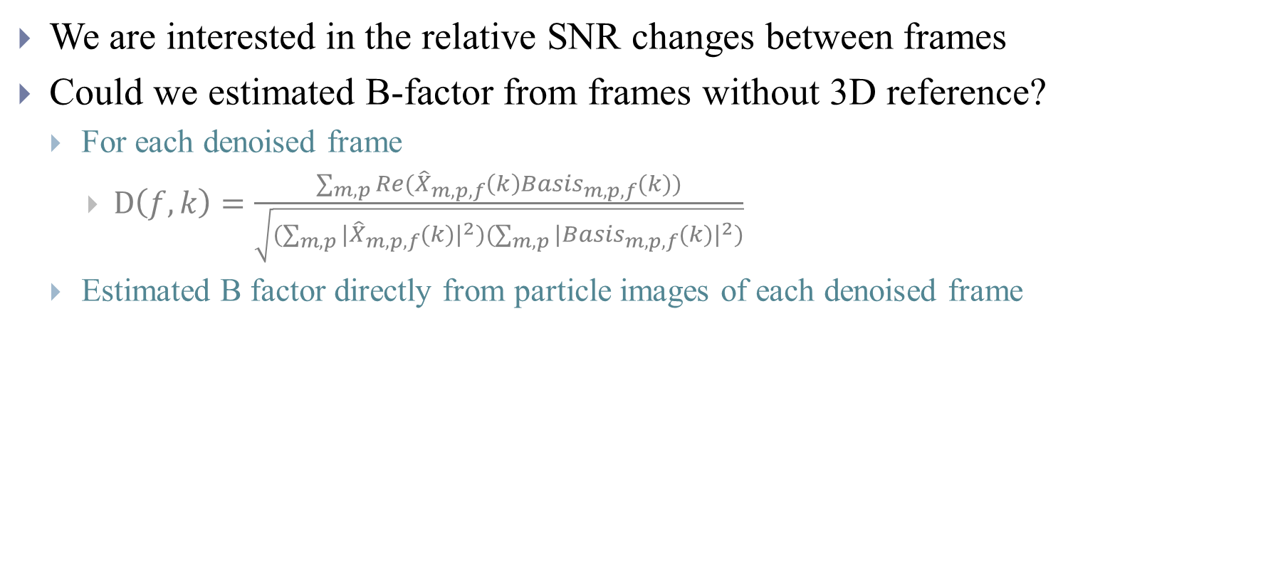
Could per-frame analysis used to estimating B-factor
We are interested in the relative SNR changes between frames
Could we estimated B-factor from frames without 3D reference?
For each denoised frame
$D\left(f,k\right)=\frac{\sum_{m,p}{Re({\hat{X}}_{m,p,f}\left(k\right){Basis}_{m,p,f}(k))}}{\sqrt{(\sum_{m,p}{{|{\hat{X}}_{m,p,f}(k)|}^{2}})(\sum_{m,p}{{|{Basis}_{m,p,f}(k)|}^{2}})}}$
Estimated B factor directly from particle images of each denoised frame
Notes:
Inner product with $B\text{⊗}A$ and particles (mrcs with each eigen images weighted eigen value?)
Take L2 norm of all particles in step 2
Frequency, size? Individual basis? (convolve use direct variance?)

Slide 12
Recent Experiments

Slide 13
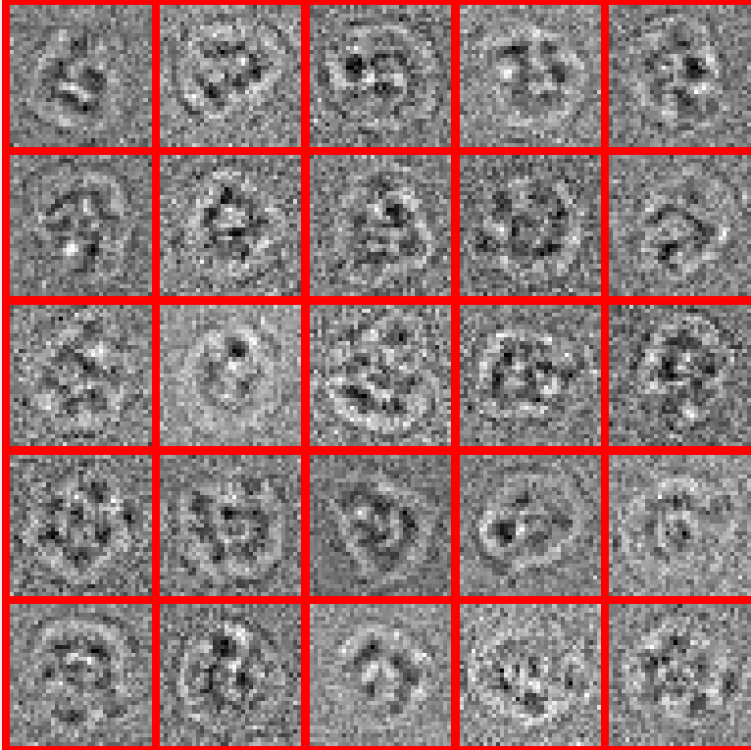
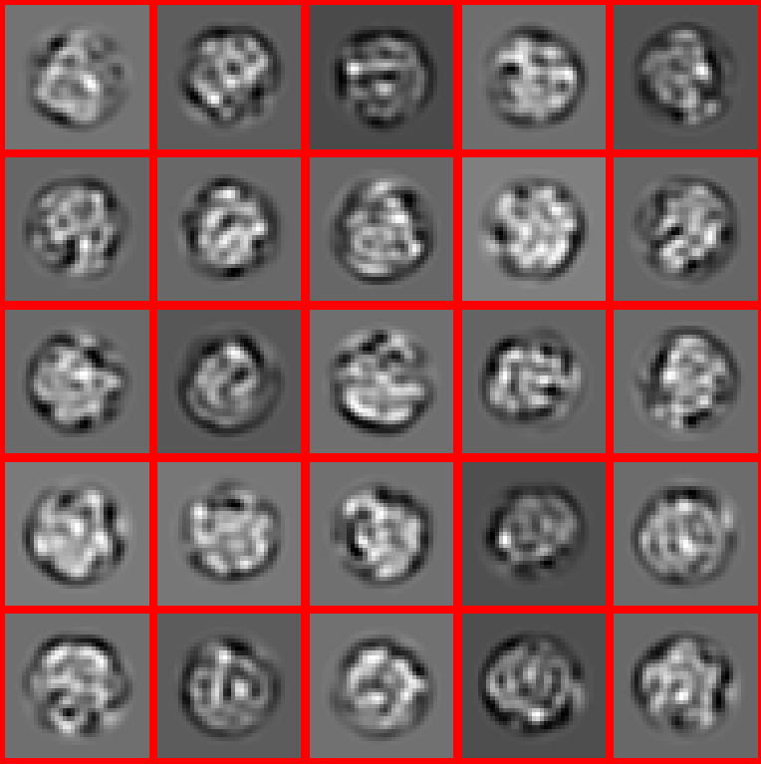
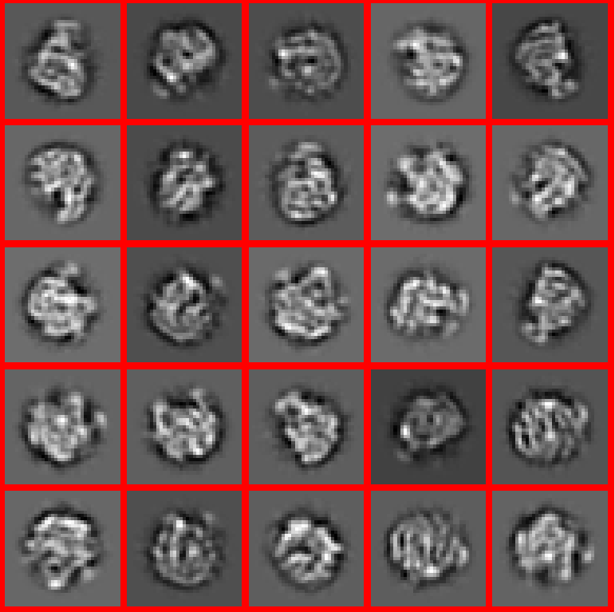
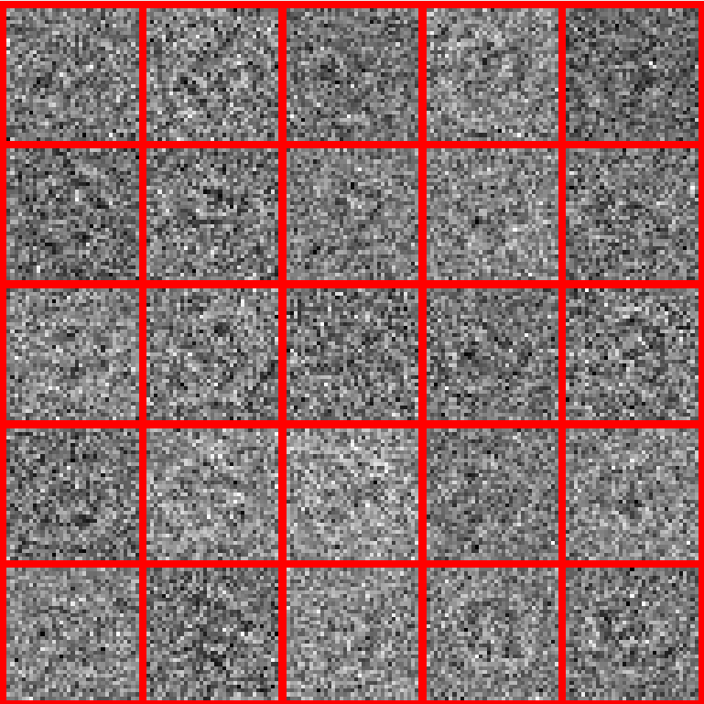
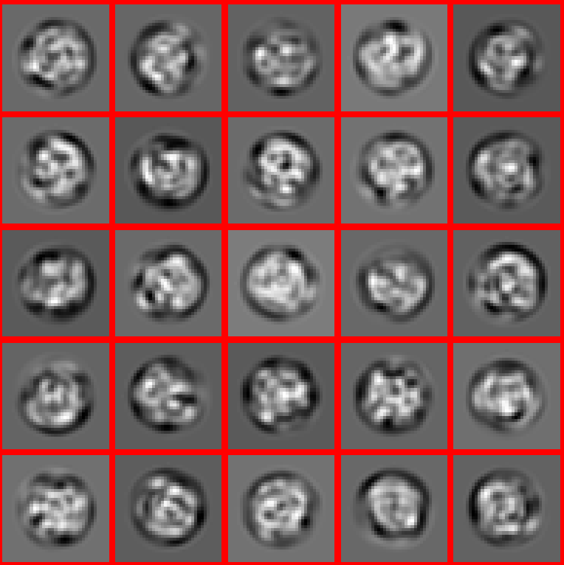
CWF_Denosing [6]
SNR =1
Denoised
80S Ribosome (Down-sample)
Box size: 35x35
Number of images: 1000
Simulated
Simulation data
Original
SNR =0.1

Slide 14
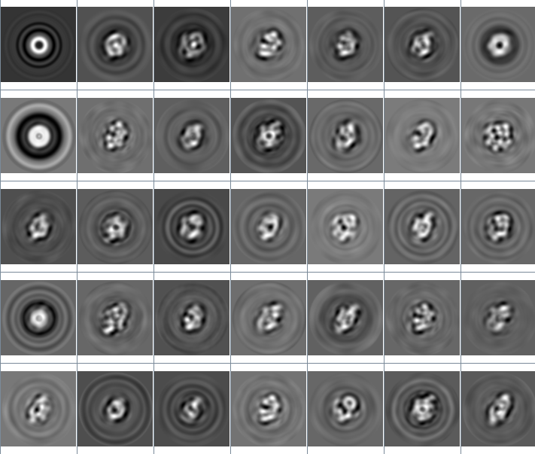
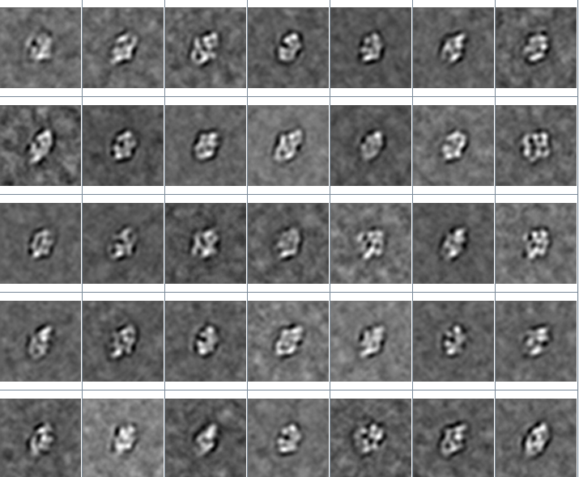
Manifold_Denosising [7]
Betagal

Slide 15
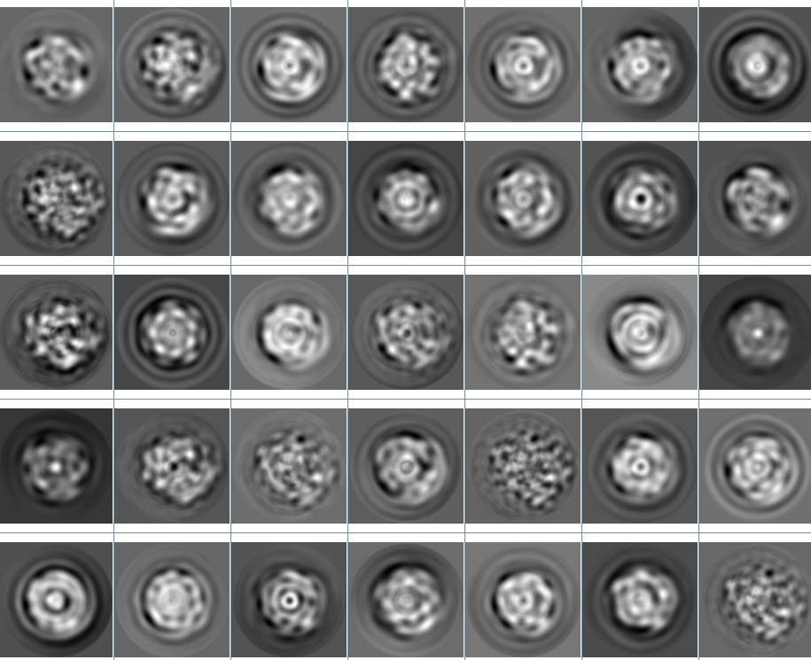
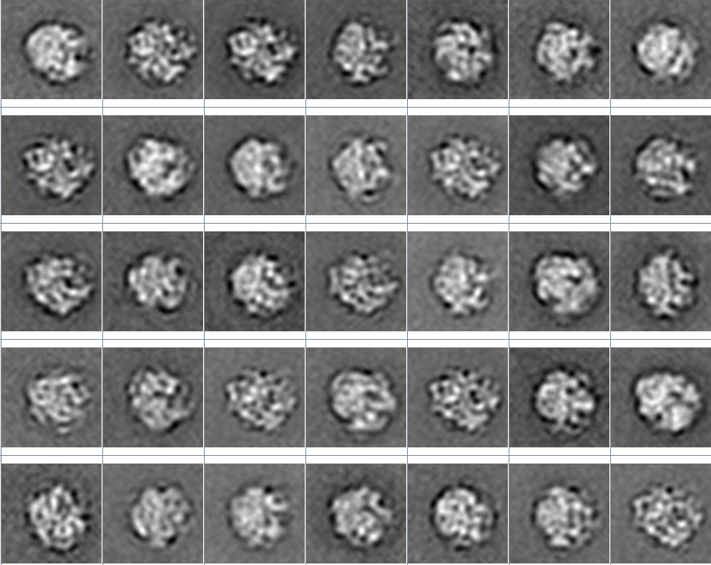
Manifold_Denosising [7]
70S Ribosome

Slide 16
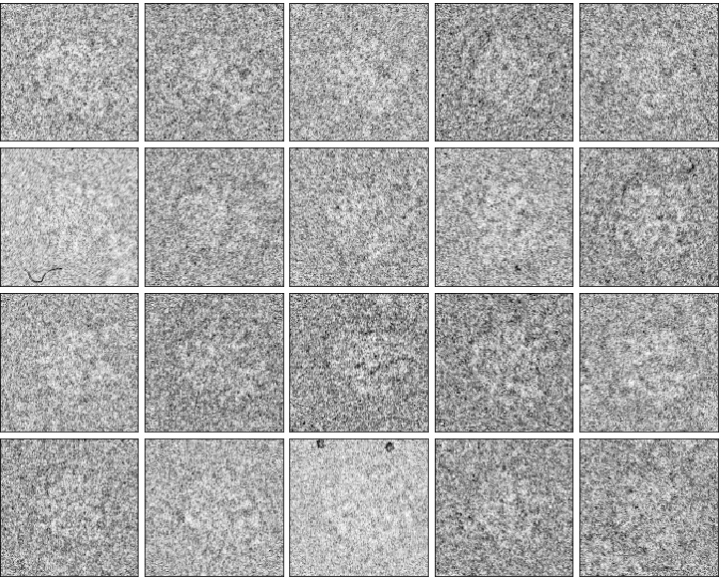
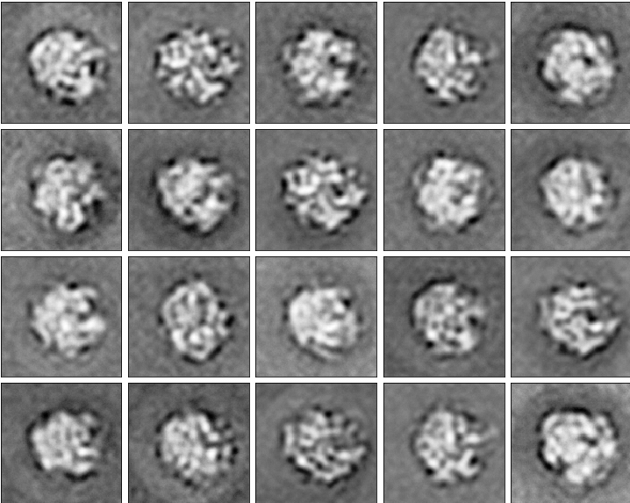
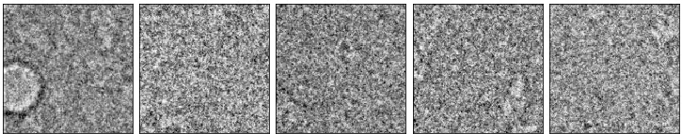
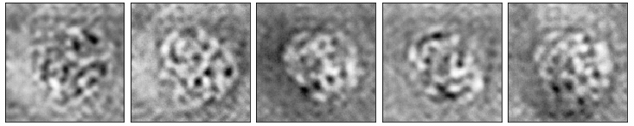
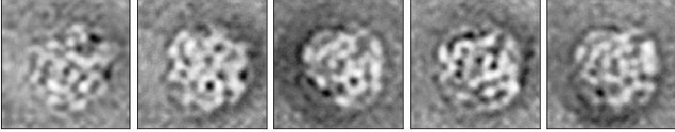
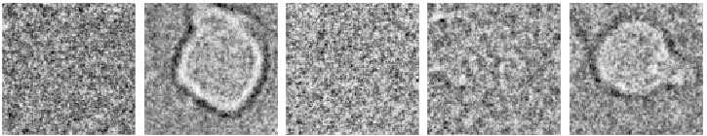
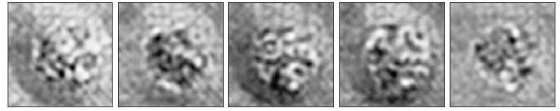
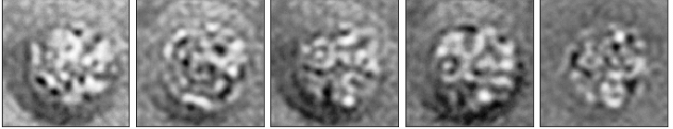
Test Outlier for 2SDR Reconstruction
Add 100 outlier to 70S Ribosome dataset
Denoise
Direct Project

Slide 17
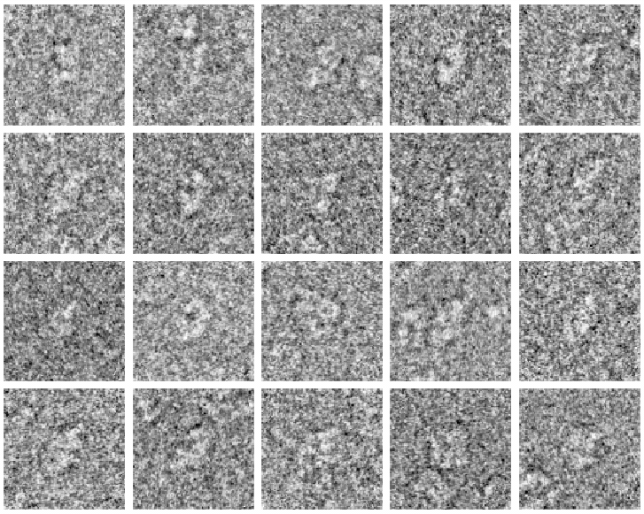
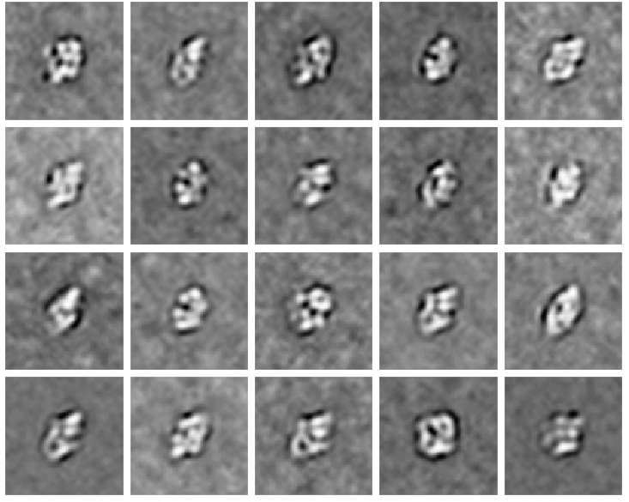
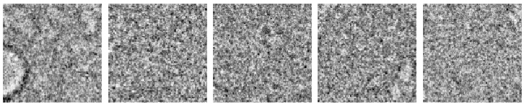
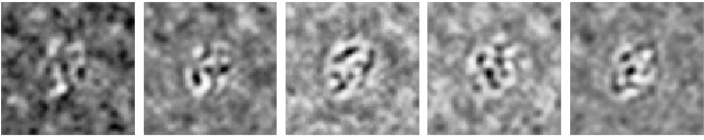
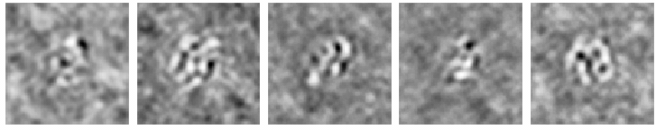
Test Outlier for 2SDR Reconstruction
Add 100 outlier to Betagal dataset

Slide 18
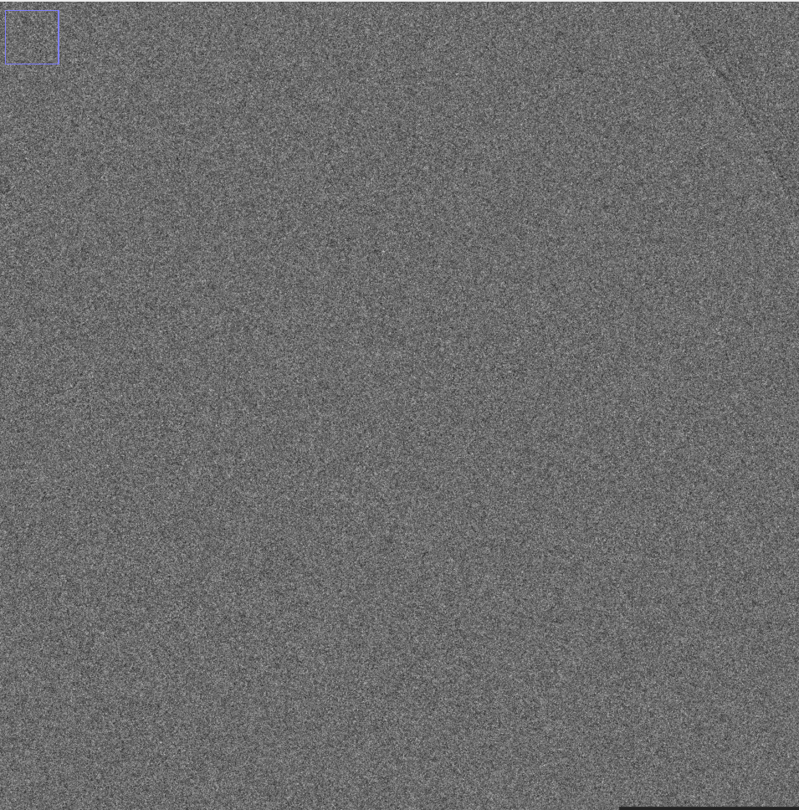
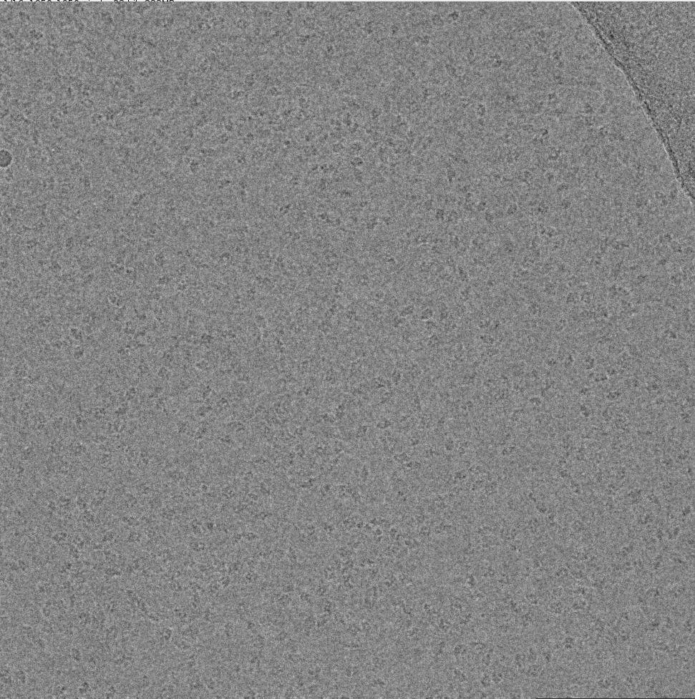
Movie processing
Single frame
Original
2SDR

Slide 19
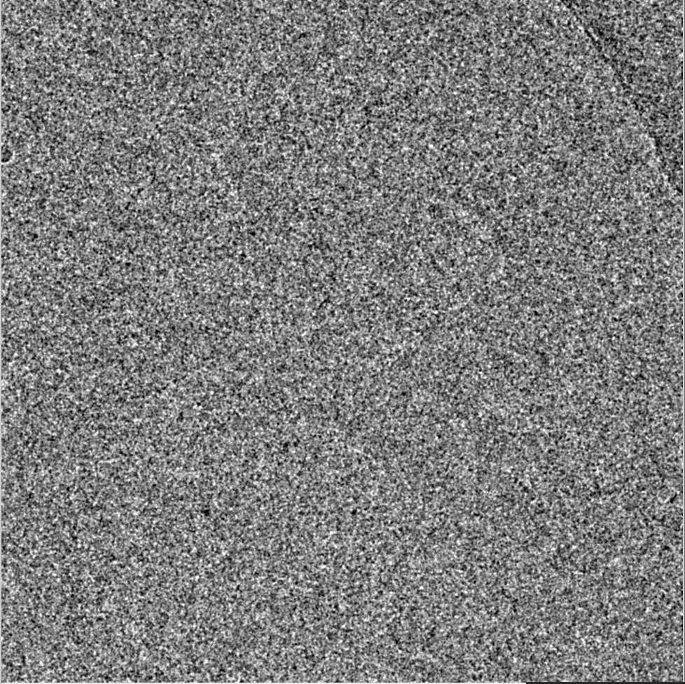
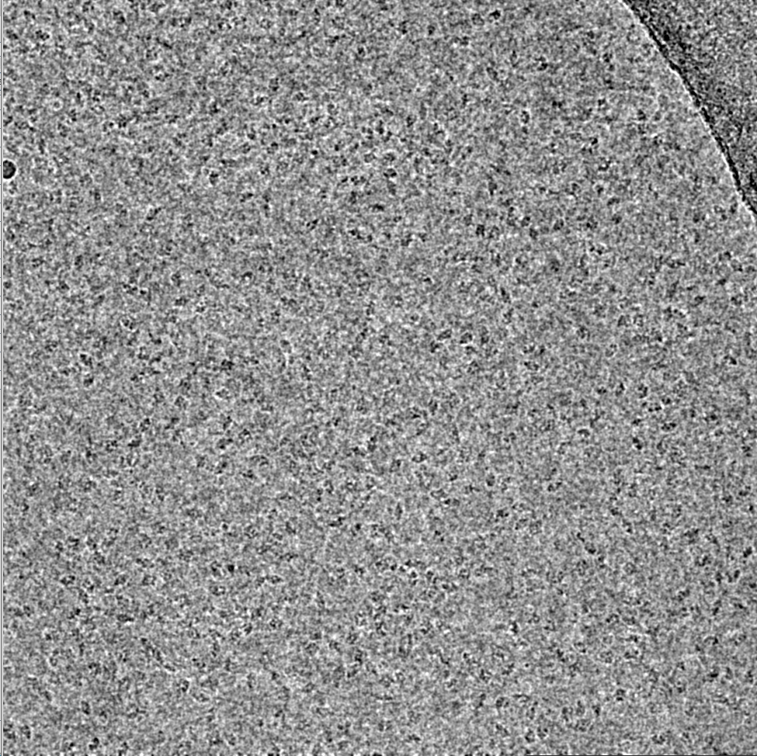
Movie processing
Contrast enhancement
Original
2SDR

Slide 20
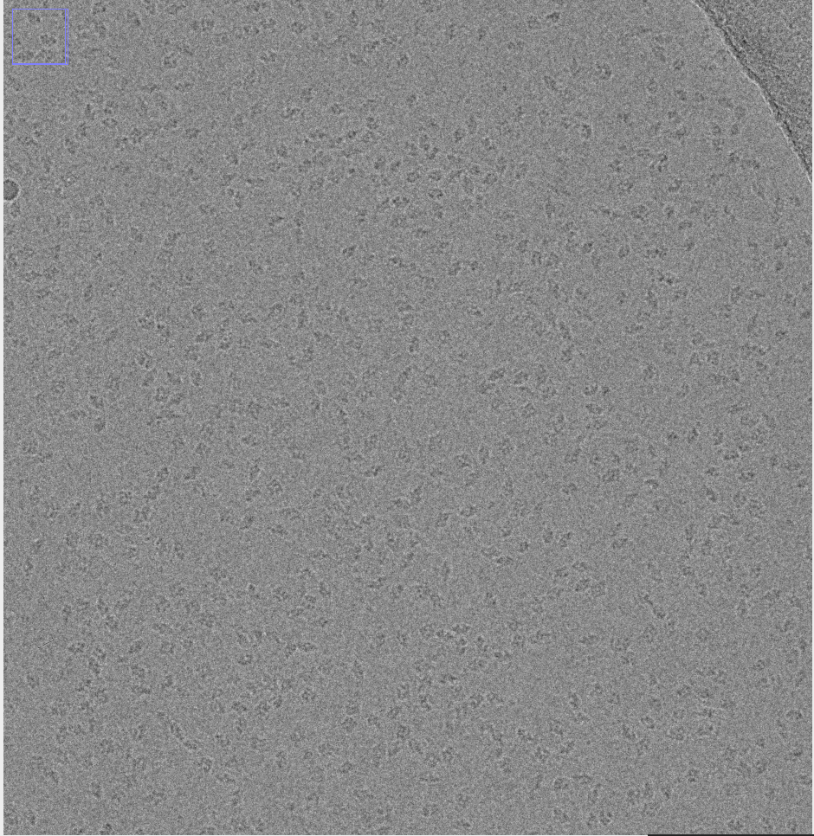
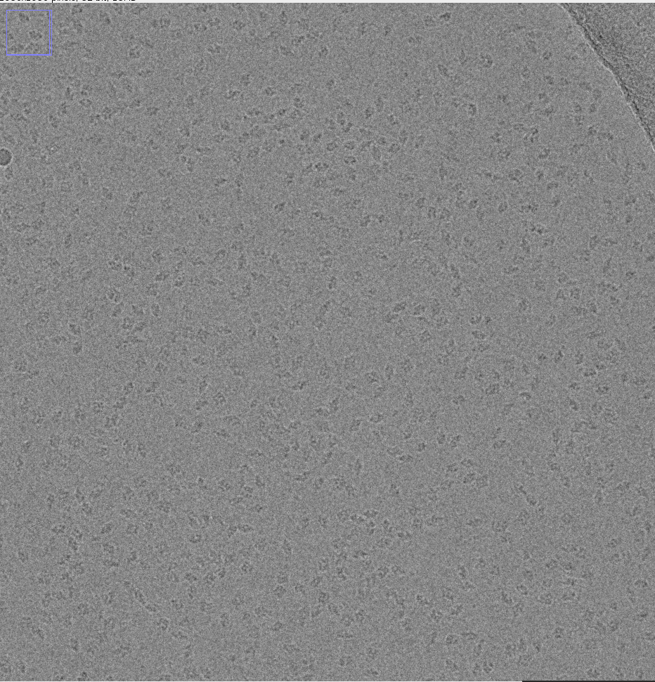
Movie processing
Motion corrected averaged
Original
2SDR

Slide 21
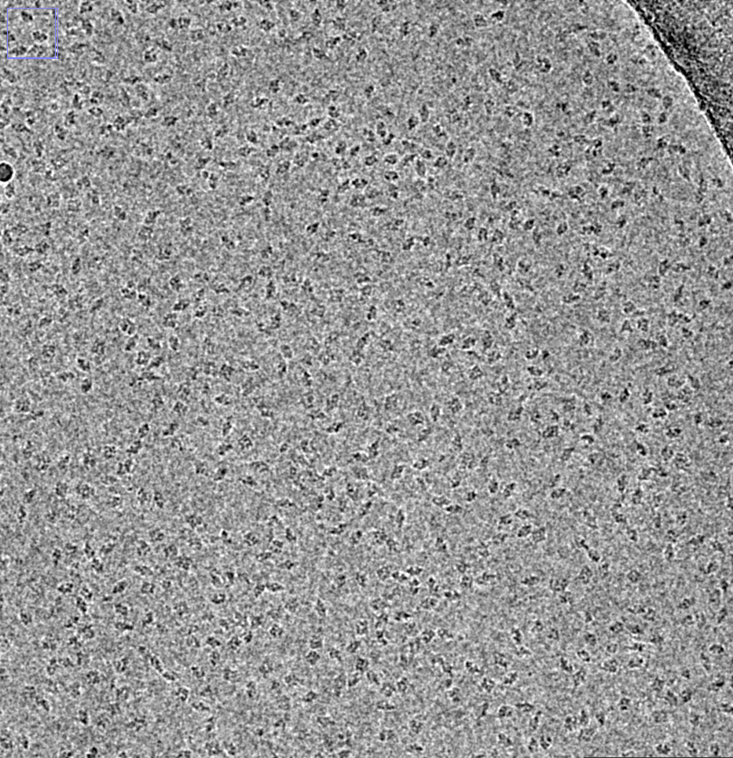
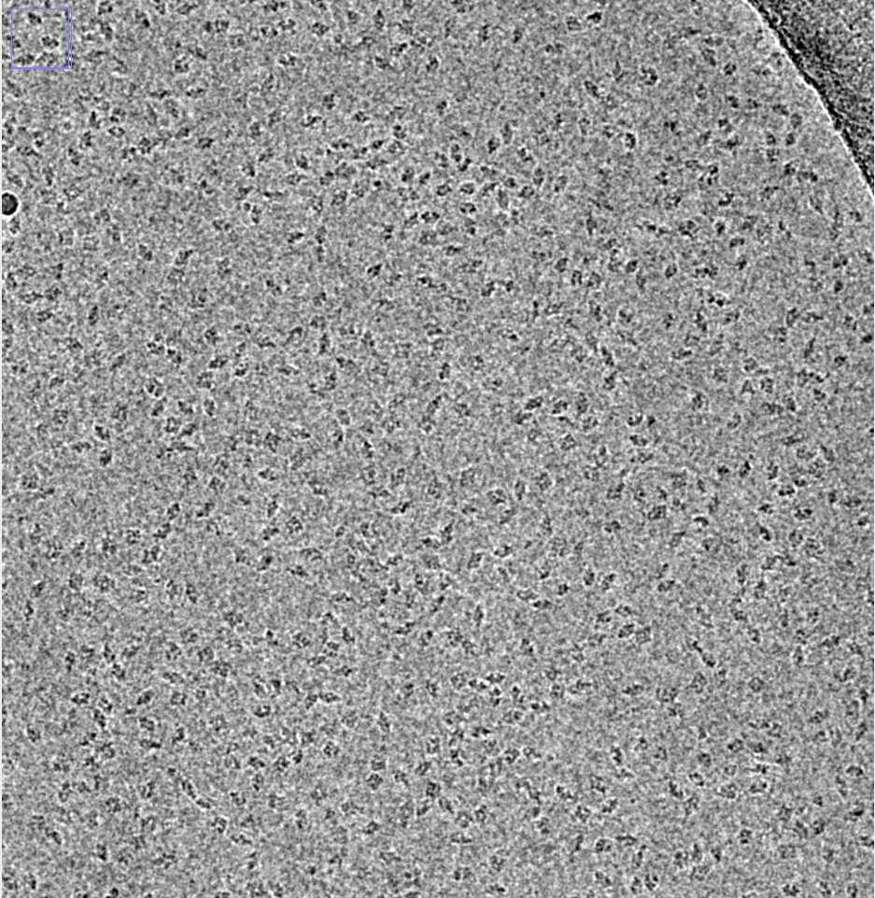
Movie processing
Contrast enhancement for motion corrected averaged
Original
2SDR

Slide 22
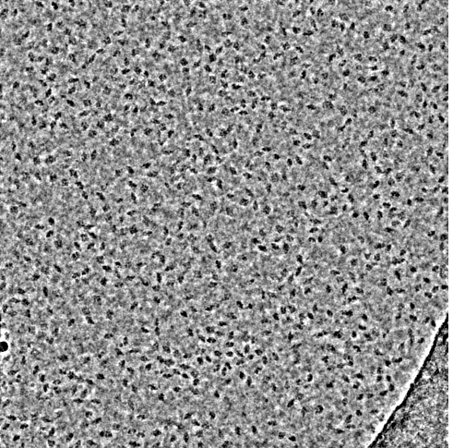
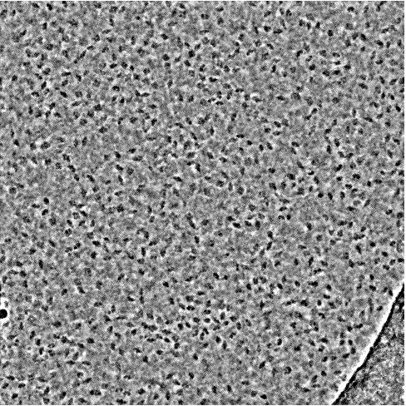
Movie processing
Further contrast enhancement on motion corrected averaged
Warp Deconvolve [8]
Noise2Noise [9]

Slide 23
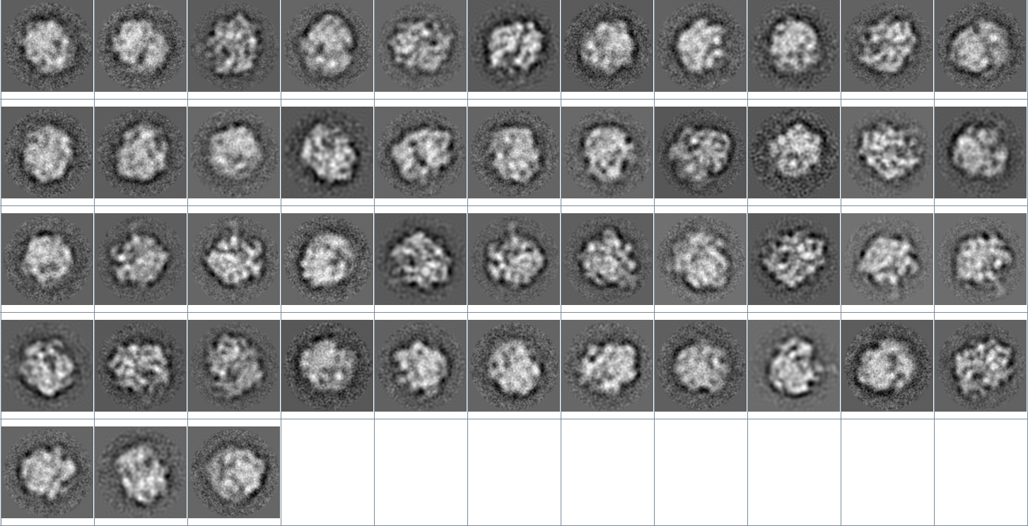
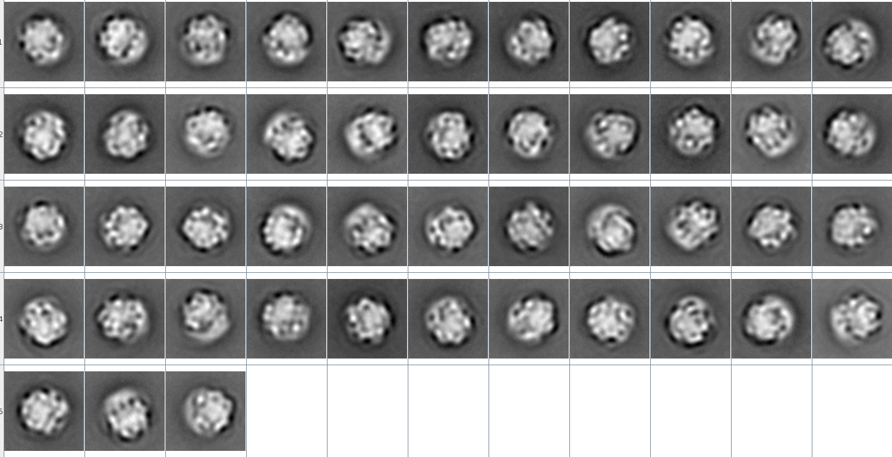

Test clustering using denoised images
Using original image to average
Using reconstructions for ISAC
Using original image for ISAC

Slide 24




Test Moment of Inertia vs Reference free aignment
Ref-free alignment [10] + r-SUP
Betagal
Original + r-SUP
2SDR Ref-free alignment + r-SUP
Moment of Inertia align to same direction + r-SUP

Slide 25
Reference
[1] Rosenthal, Peter B., and Richard Henderson. "Optimal determination of particle orientation, absolute hand, and contrast loss in single-particle electron cryomicroscopy." Journal of molecular biology 333.4 (2003): 721-745
[2] Baker, Lindsay A., et al. "The resolution dependence of optimal exposures in liquid nitrogen temperature electron cryomicroscopy of catalase crystals." Journal of structural biology 169.3 (2010): 431-437.
[3] Grant, Timothy, and Nikolaus Grigorieff. "Measuring the optimal exposure for single particle cryo-EM using a 2.6 Å reconstruction of rotavirus VP6." Elife 4 (2015): e06980.
[4] Scheres, Sjors HW. "Beam-induced motion correction for sub-megadalton cryo-EM particles." Elife 3 (2014): e03665.
[5] Zivanov, Jasenko, Takanori Nakane, and Sjors HW Scheres. "A Bayesian approach to beam-induced motion correction in cryo-EM single-particle analysis." IUCrJ 6.1 (2019).
[6] Bhamre, Tejal, Teng Zhang, and Amit Singer. "Denoising and covariance estimation of single particle cryo-EM images." Journal of structural biology 195.1 (2016): 72-81.
[7] Landa, Boris, and Yoel Shkolnisky. "The Steerable Graph Laplacian and its Application to Filtering Image Datasets." SIAM Journal on Imaging Sciences 11.4 (2018): 2254-2304.
[8] Tegunov, Dimitry, and Patrick Cramer. "Real-time cryo-EM data pre-processing with Warp." BioRxiv (2018): 338558.
[9] https://github.com/ZhenyuTan/Noise2Noise-Cryo-EM-image-denoising
[10] Penczek, Pawel, Michael Radermacher, and Joachim Frank. "Three-dimensional reconstruction of single particles embedded in ice." Ultramicroscopy 40.1 (1992): 33-53.

